Slide 1
Research on Research on Research:
Analyzing historical trends in statistical and
computational research from the 1990s to
modern day
By Naren Prakash

Slide 2

Introduction
Research on Research on Research
How has the current research landscape for statistical and computational fields changed in the past 30 years?

Slide 3
Research Questions
Research on Research on Research
What statistical and computational fields have seen the largest increase in publications?
no
How have the most published statistical and computational fields changed over time?
yes
no
What statistical and computational fields are projected to grow the most in the coming years?
yes
no
no

Slide 4
What does our data look like?
Research on Research on Research
136,238 observations and 10 columns
Column names: id, title, category, category code, published date, updated date, authors, first author, summary, and summary word count
Originally scraped from arXiv, dataset from Kaggle
We partition the dataset into two further datasets:
A statistical dataset
A computational dataset

Slide 5
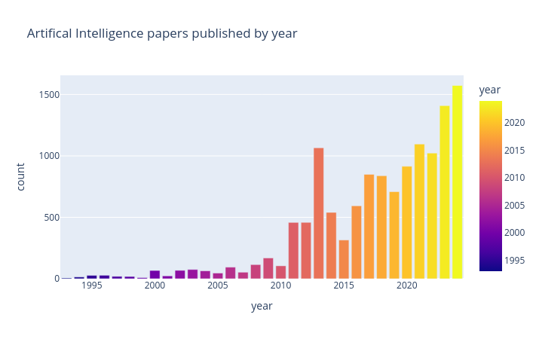
EDA Plot
Research on Research on Research
Plot of paper output for a category in the original dataset: Artificial Intelligence

Slide 6
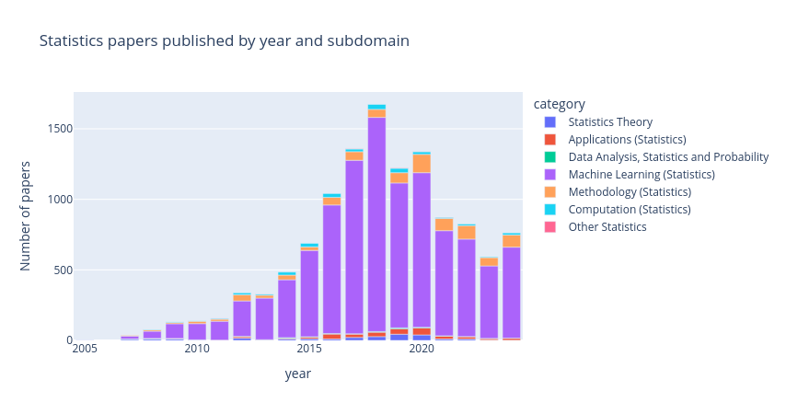
Statistical EDA Plot
Research on Research on Research
Plot of paper output for the statistical data

Slide 7
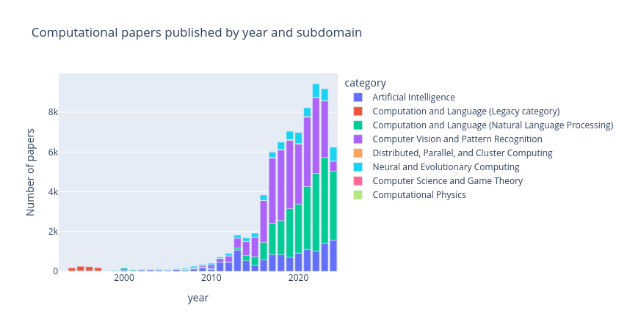
Computational EDA Plot
Research on Research on Research
Plot of paper output for the computational data

Slide 8
Statistical Data Analysis
Research on Research on Research

Slide 9
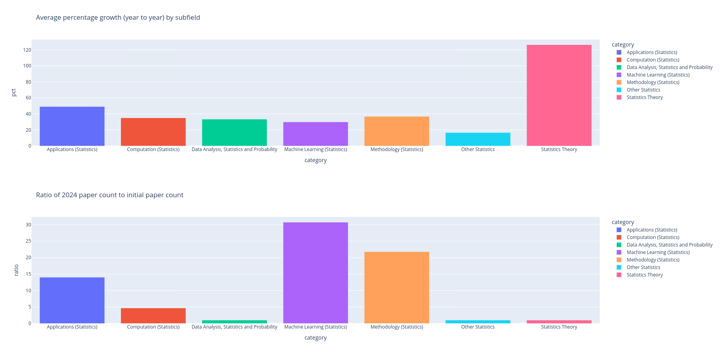
What fields had the largest publication increase?
Research on Research on Research
Most growth: Machine Learning, Methodology, Applications

Slide 10
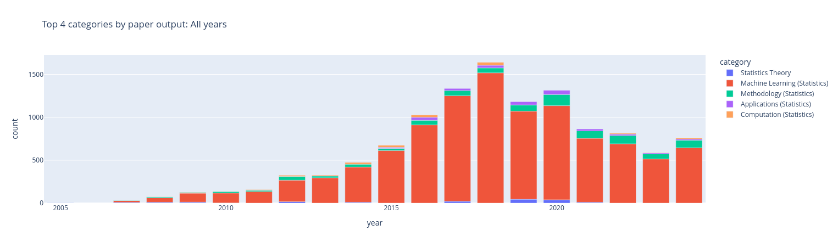
How have the top fields changed?
Research on Research on Research
Top 3 fields remained Machine Learning, Methodology,and Application/Computation

Slide 11
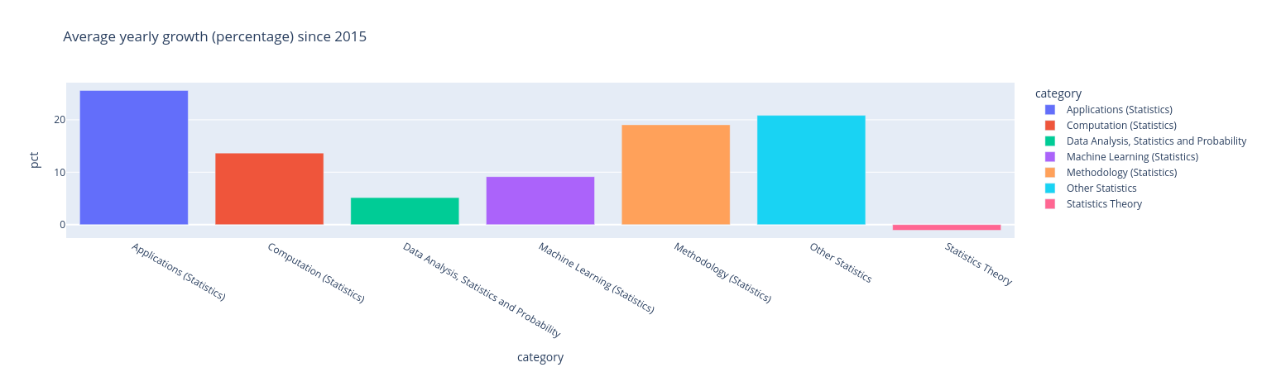
What fields are growing the most recently?
Research on Research on Research
Looking at recent average growth

Slide 12
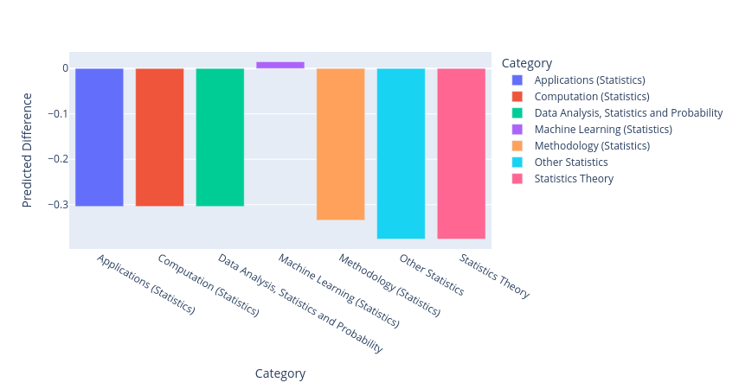
What fields are growing the most recently?
Research on Research on Research
Using a time series model

Slide 13
Computational Data Analysis
Research on Research on Research

Slide 14
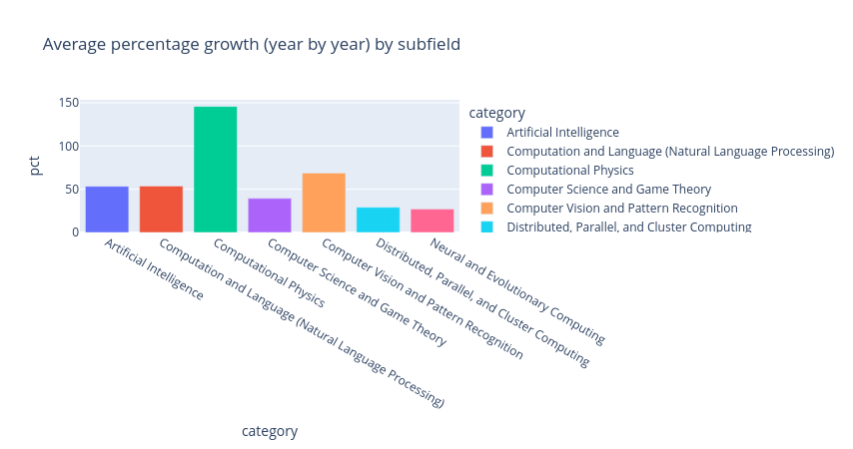
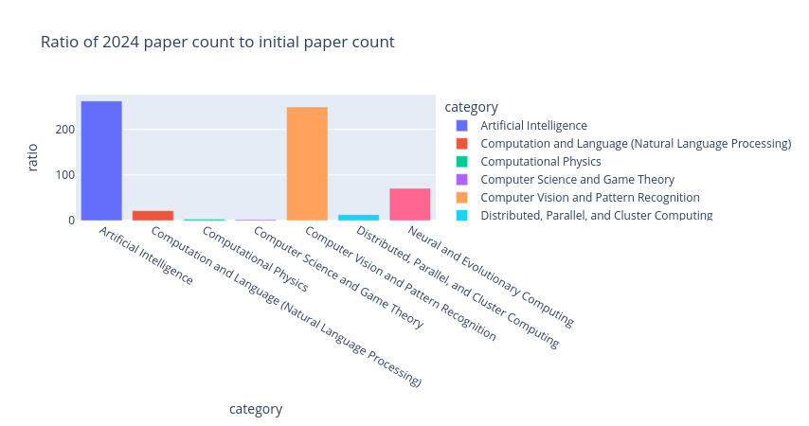
What fields had the largest publication increase?
Research on Research on Research
Most growth: Artificial Intelligence, Computer Vision, Neural and Evolutionary Computing

Slide 15
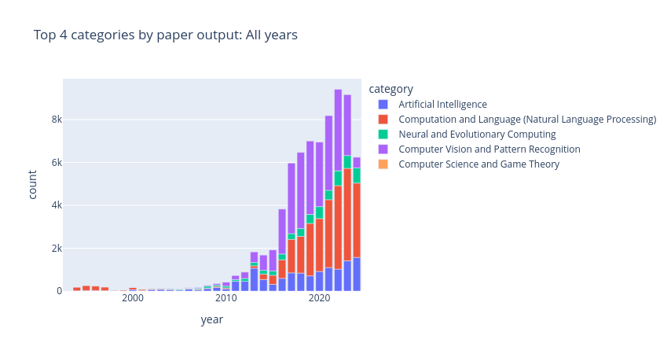
How have the top fields changed?
Research on Research on Research
Top 3 fields remained Artificial Intelligence, Computation and Language (NLP), Computer Vision and Pattern Recognition

Slide 16
What fields are growing the most recently?
Research on Research on Research
Looking at recent average growth
  Similar to previous publication increase plot
  Still Artificial Intelligence, Computer Vision, Neural and Evolutionary Computing

Slide 17
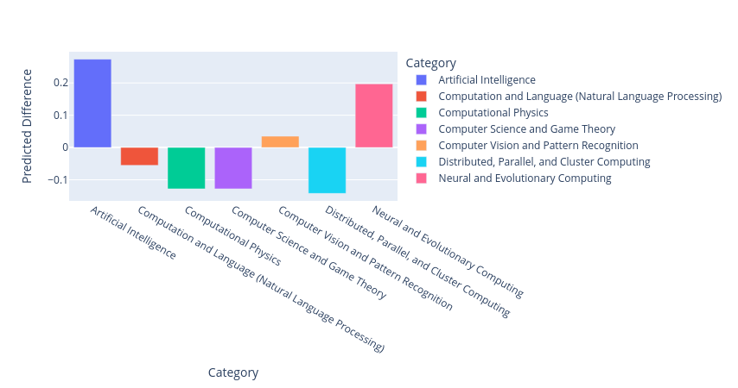
What fields are growing the most recently?
Research on Research on Research
Using a time series model

Slide 18
Conclusion
Research on Research on Research
Recap
Top subfields fairly consistent for both statistical and computational fields
Statistical time series model projects short term increase for ML papers, decrease for others
Computational time series model projects growth in Neural and Evolutionary Computing, along with established top subfields

